Slide 1

Understanding political science and its concepts
Hasan Muhammad Baniamin

Slide 2
Politics
Politics is the competition among individuals and groups pursuing their own interests.
Politics is the exercise of power and influence to allocate things that are valued.
Politics is the determination of who gets what, when, and how.
Politics is the resolution of conflict.

Slide 3
Politics
Politics is the process through which power and influence are used in the promotion of certain values and interests (Danziger and Smith, 2016).

Slide 4
Political Knowledge
If you have discussed politics with your friends, you probably have noticed that they differ,
They different in terms of how much they know about politics and in their opinions about what constitute good and bad political actions.

Slide 5
Types of Political Knowledge
Three types:
  Descriptions of political facts;
  Explanations of how and why politics occurs as it does; and
  Prescriptions of what should happen in the political world.

Slide 6
Description
Many bits of political knowledge offer a description, which focuses on what questions and is usually based on one or more “facts.”
Example:
  Bangladesh became independent on December 16, 1971
  The date Hosni Mubarak resigned as President of Egypt: February 11, 2011

Slide 7
Explanation
It attempts to specify why something happens and to provide the reason or process by which the phenomenon occurs.
Example:
  Why did the people from Bangladesh went for the struggle for independence?

Slide 8
Prescription
A prescription is a value judgment that indicates what should occur and should be done.
Example:
  Economic growth and distribution of wealth.
Prescription is based on normative political knowledge—your value judgments.

Slide 9

What is your prescription at the current situation in the country?

Slide 10
Sources of Political Knowledge
Three sources:
  Authority;
  Personal thought; and
  Science.

Slide 11
Authority
The method of authority involves the appeal to any document, tradition, or person believed to possess the controlling explanation regarding a particular issue.
Knowledge about politics can be based on three kinds of authority sources:
  (1) a specific authority (ex: parent, teacher, friend, or famous person);
  (2) a general authority (constitutions, revered leaders, widely respected media or books, and religious teachings.);
  (3) “everyone.”
Problem: Can be wrong and misguide you.

Slide 12
Personal Thought
This second source of knowledge does not rely on outside authorities; rather, it assumes that the individual can use his own rationality, intuition, or personal experience to assess a knowledge claim.
  Rationality: You probably have decided that a certain claim is true because it is logical or obvious—it “just makes sense” to you. Example: Investment in the stock market.
  Intuition: Here, one’s knowledge is based on feeling, on a sense of understanding or empathy, rather than on reason. Example: Investment in the stock market.
  Personal experience: You can also be convinced that something is true because of your personal experiences. Example: Experience with any public agency.

Slide 13
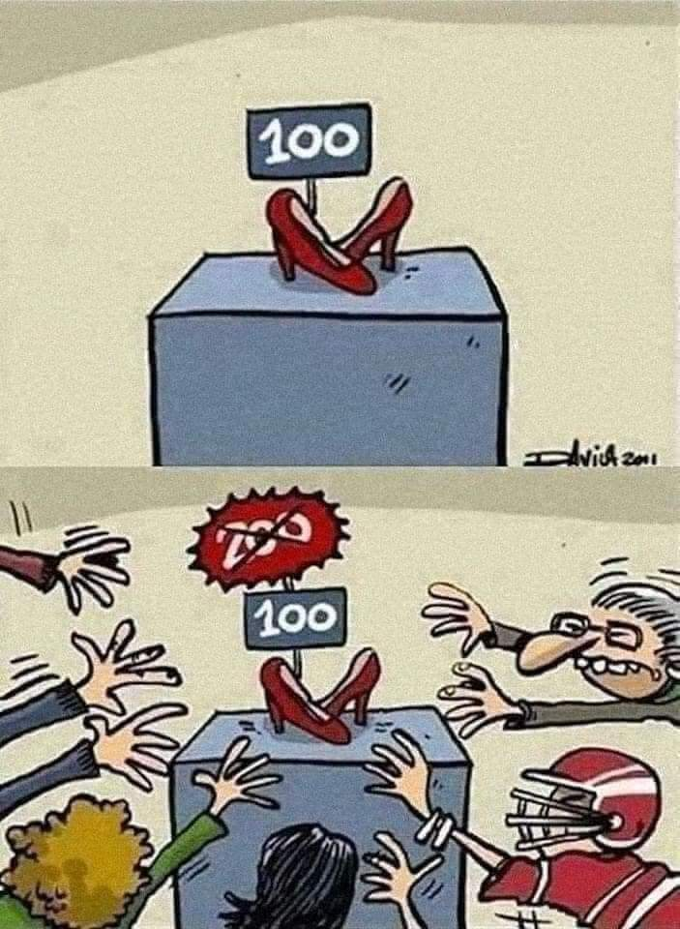

Slide 14
Personal Thought
Problem:
  Even rational thought will not necessarily enable people to agree on political facts. We do not all employ the same logic, and it is rare to find a knowledge claim that everyone agrees is obviously correct.
  There is no reason to assume that different people will share the same intuitive feelings regarding what is true.
  People have different personal experiences, they are unlikely to reach the same conclusions about what is true.

Slide 15
Science
Science uses explicit methods that attempt to enable different people to agree about what they know.
The goal of any science is to describe and explain—to answer what, why, and how questions.
There are four essential characteristics of the scientific method:
  Science is empirical in the sense that it is concerned with phenomena that can be observed or at least measured.
  Science entails a search for regularities in the relationships among phenomena.
  Science is cumulative because it tentatively accepts previously established knowledge
  The method of science is testable.

Slide 16
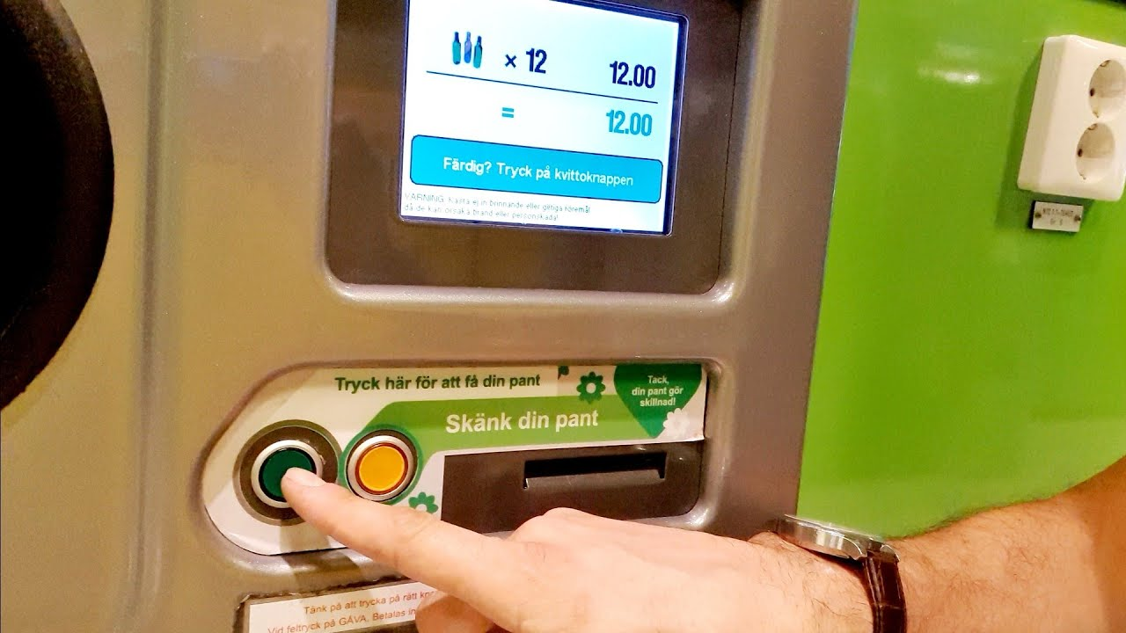

Slide 17
Science
Scientific method has some major advantages over the methods of authority and personal thought.
Challenges/Problems: sometimes difficult to explain the causality of something.
Causality and Correlation:
  Correlation is a relationship where changes in one factor appear when there are changes in another factor (Example: Irrigation and Rice Production).
  Causality: Whether that specific factor actually responsible for the change of other factor.

Slide 18
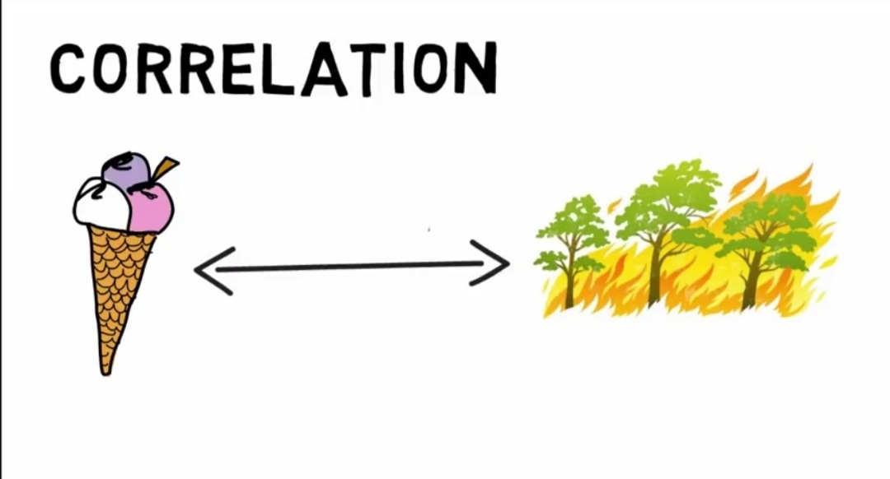

Slide 19
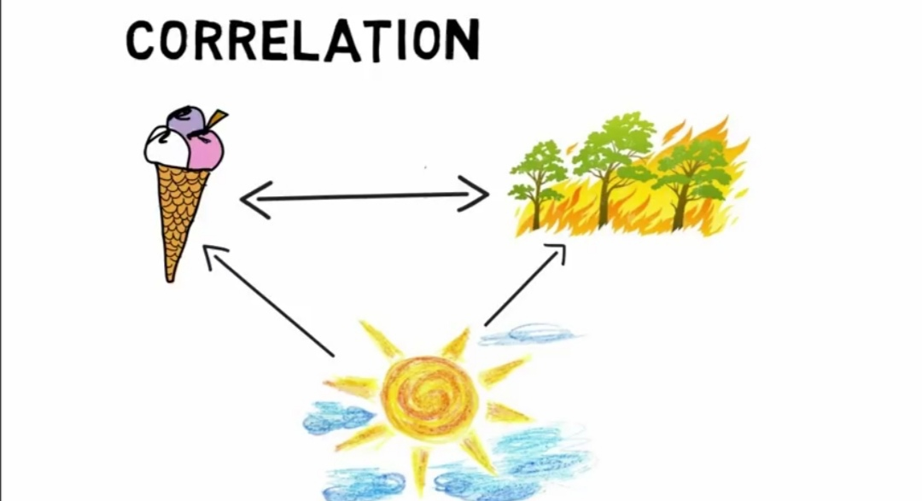

Slide 20
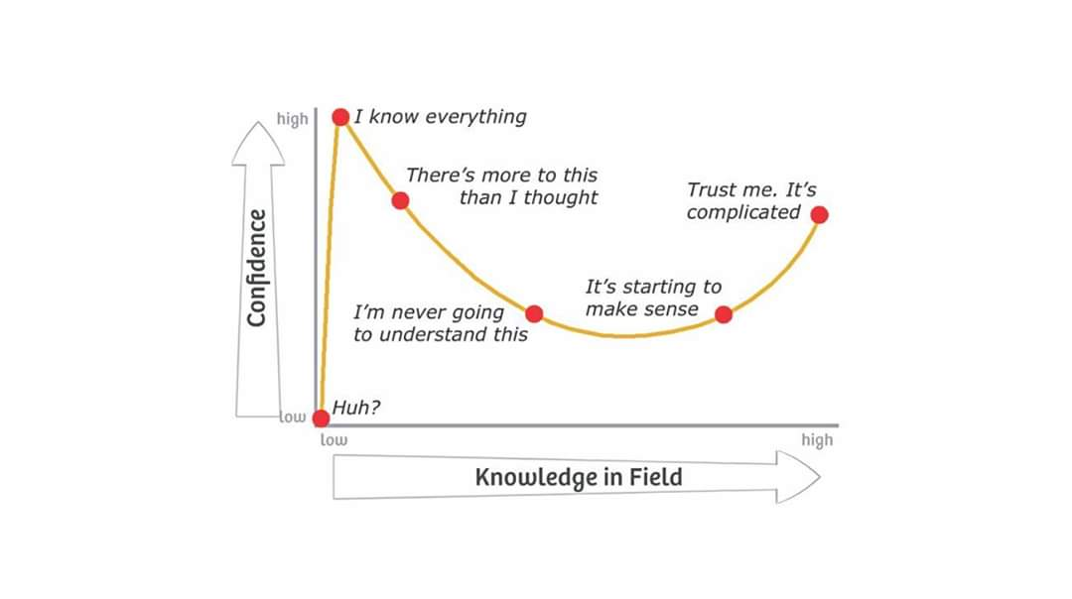
Dunning-Kruger effect

Slide 21
Political analysis
Political analysis is the attempt to describe (to answer the what questions) and then to explain politics (to answer the why and how questions).

Slide 22
Political Science
A set of techniques, concepts, and approaches whose objective is to increase the clarity and accuracy of our understandings about the political world (Danziger and Smith, 2016).

Slide 23


Slide 24
Suggested readings
Danziger, J. N., & Smith, C. A. (2016). Understanding the political world: A comparative introduction to political science. Boston :Pearson. Chapter 1.

Slide 25
Q?

